Slide 1




Residential Occupancy Analysis Using Motion Sensors
Longqi Yang ¹ Kevin Ting ² Pandarasamy Arjunan³ Mani B. Srivastava²
¹Zhejiang University ² University of California, Los Angeles
³Indraprastha Institute of Information Technology Delhi

Slide 2
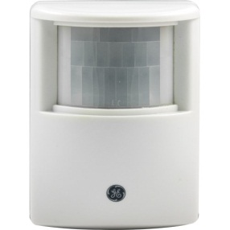
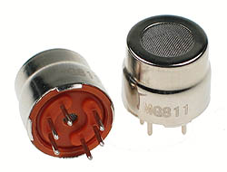
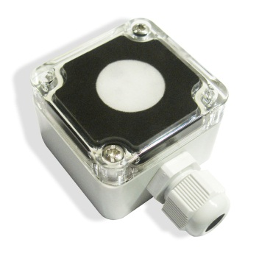
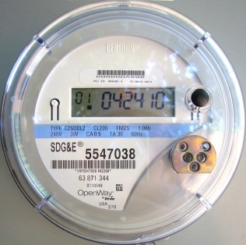
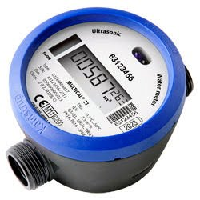
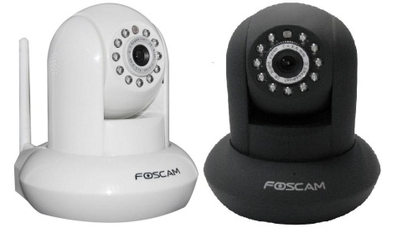
Introduction and Background
Motion Sensor
CO₂ Sensor
Occupancy Inference
Light Sensor
Electric Meter
Camera
Water Meter
http://www.jascoproducts.com lcn-usa.us http://www.lelong.com.my http://www.futurlec.com http://www.conserve-energy-future.com http://majikphil.blogspot.com

Slide 3
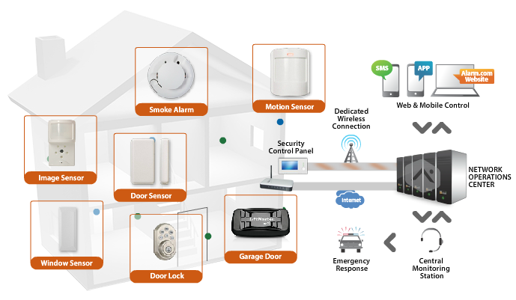
Introduction and Background
Sophisticated Service Provided by Security System
-Alarm.com
Commonly Installed
http://www.alarm.com/

Slide 4
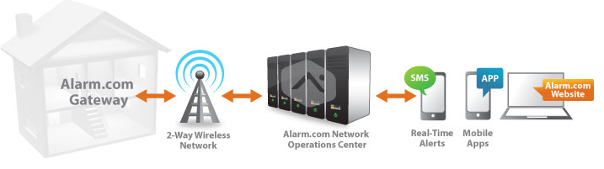
Introduction and Background
Significance
-Privacy Concern
-Extra Service
Motion Sensor-Based Inference
(House-Level)
-Number
-Identity
http://www.alarm.com/

Slide 5
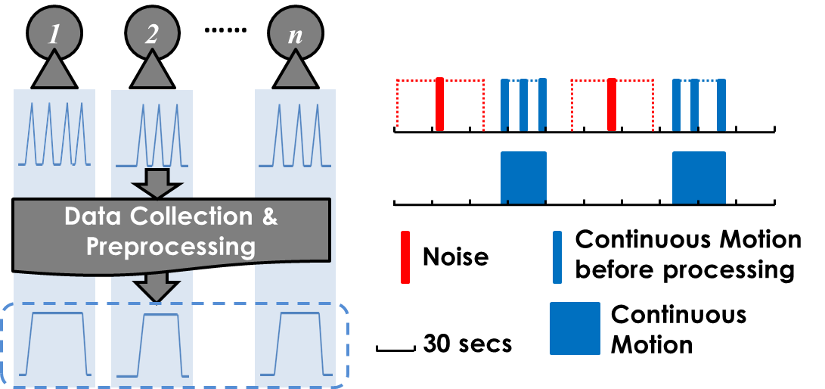
Methodology
Data Collection and Preprocessing
-Data Collection(Xively)
-Noise Reduction
-Continuous Motion Detection

Slide 6
Methodology
Two Sets of Methods
-Learning-based Method
-Rule-based Method
Basic Idea-Learning based
-Motion sensors represent the rooms occupied each time
-People may have different ‘occupancy pattern’
-Rooms occupied frequently by a specific occupant
-Time of the room usage

Slide 7
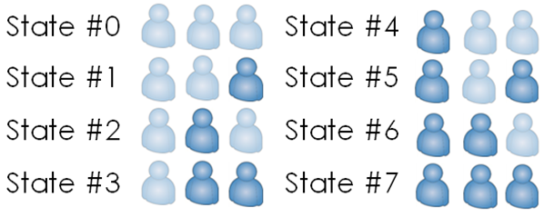
Methodology
Learning Based Method
Generative Model
-Conditional Hidden Markov Model(HMM)
Discriminative Model
-Hidden Markov- Support Vector Machine(HM-SVM)
-Conditional Random Field(CRF)
P1 P2 P3
P1 P2 P3
Hour of Day
Preprocessed Motion Sensor Data

Slide 8
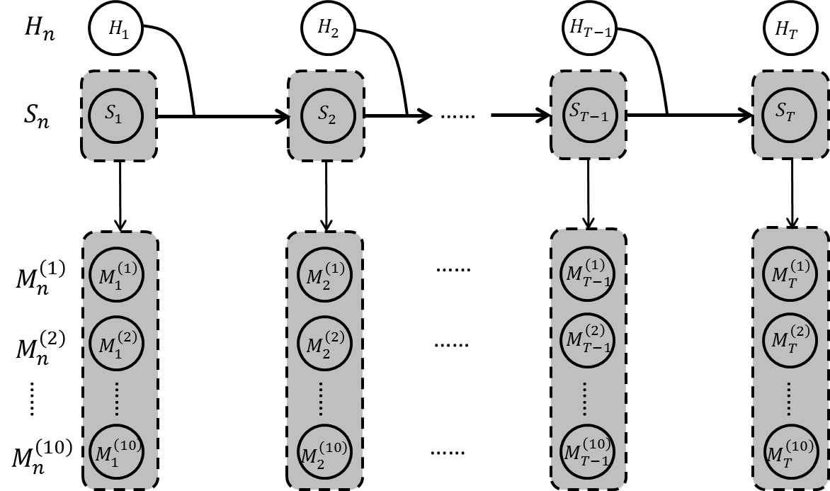



Methodology
Conditional Hidden Markov Model(HMM)
-Directly describe the behavior of each person
-Generative Model-p(x,y)
$$M_{n}^{\left(1\right)},M_{n}^{\left(2\right)},…,M_{n}^{\left(10\right)}\left(n=1,…,T\right):$$
Motion Sensor #1 to #10
$$S_{n}\left(n=1,…,T\right):$$
State Number#
$$H_{n}\left(n=1,…,T\right):$$
Hour of Day
Time

Slide 9
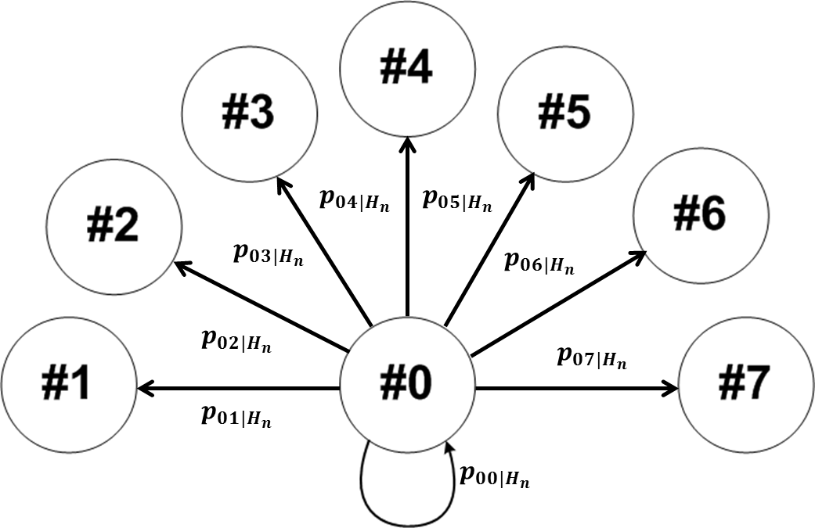
Methodology
Conditional Hidden Markov Model(HMM)

Slide 10
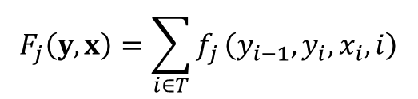
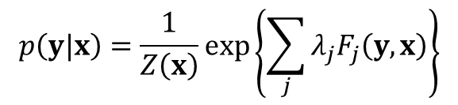
Methodology
Conditional Random Field(CRF)
-Classification in all possible hidden chains
-Observation:
Motion Sensors + Hour of day
-Model the Posterior Probability p(y|x)
$$p\left(y|x\right)=\frac{1}{Z\left(x\right)}exp\left\{\sum_{j}{λ_{j}F_{j}\left(y,x\right)}\right\}$$
$$F_{j}\left(y,x\right)=\sum_{i∈T}{f_{j}}\left(y_{i−1},y_{i},x_{i},i\right)$$
F: feature function f: indicator function
Sutton, Charles, and Andrew McCallum. "An introduction to conditional random fields for relational learning." Introduction to statistical relational learning 93 (2007): 142-146. CRF++ http://crfpp.googlecode.com/svn/trunk/doc/index.html#download

Slide 11
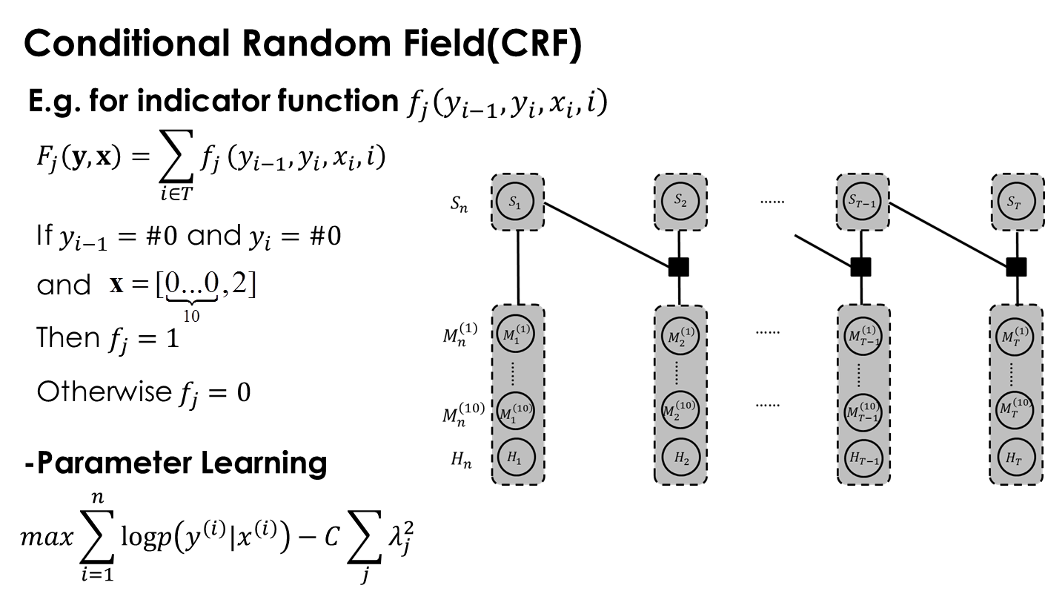
Methodology
Sutton, Charles, and Andrew McCallum. "An introduction to conditional random fields for relational learning." Introduction to statistical relational learning 93 (2007): 142-146. CRF++ http://crfpp.googlecode.com/svn/trunk/doc/index.html#download

Slide 12


Methodology
Hidden Markov- Support Vector Machine(HM-SVM)
-Basically a discriminative model
-Classification in all possible hidden chains
-Observation:
Motion Sensors + Hour of day
-Input-Output Mapping via feature indicator Functions
$$f\left(x\right)=arg\max_{y}F\left(x,y;ω\right)$$
$$F\left(x,y;ω\right)=〈ω,Φ\left(x,y\right)〉$$
Feature Indicator Function
SVMHMM Version V3.10 http://www.cs.cornell.edu/people/tj/svm_light/svm_hmm.html

Slide 13

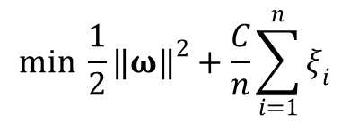


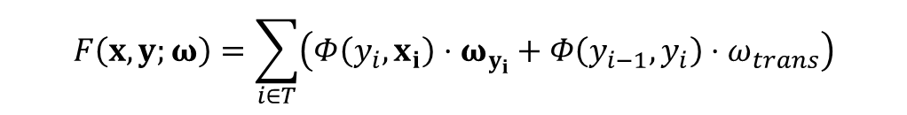


Methodology
Hidden Markov- Support Vector Machine(HM-SVM)
-First-Order transition and Zero-Order emission
-Criteria of ‘maximum margin’
$$Φ\left(y_{i−1},y_{i}\right)$$
$$ω_{trans}$$
$$Φ\left(y_{i},x_{i}\right)$$
$$ω_{y_{i}}$$
$$F\left(x,y;ω\right)=\sum_{i∈T}{\left(Φ\left(y_{i},x_{i}\right)⋅ω_{y_{i}}+Φ\left(y_{i−1},y_{i}\right)⋅ω_{trans}\right)}$$
$$γ_{j}=F\left(x^{j},y^{j}\right)−\max_{y≠y^{j}}F\left(x^{j},y\right)$$
$$min \frac{1}{2}{‖ω‖}^{2}+\frac{C}{n}\sum_{i=1}^{n}{ξ_{i}}$$
$$s.t. F\left(x_{i},y_{i}\right)−\max_{y≠y_{i}}F\left(x_{i},y\right)≥1−ξ_{i},{ ξ}_{i}≥0,∀i$$
SVMHMM Version V3.10 http://www.cs.cornell.edu/people/tj/svm_light/svm_hmm.html

Slide 14
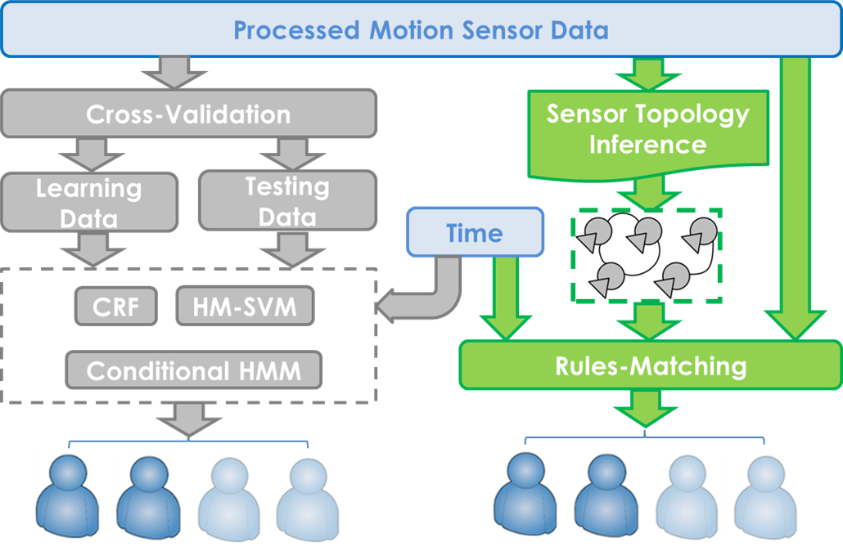
Methodology
Occupancy Inference
-Learning-Based/Rule-Based Method

Slide 15
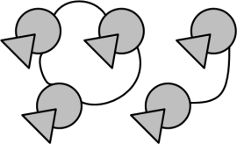
Methodology
Rule-Based Method
Step 1: Sensor Topology Inference
-Detect the ‘signal’ of connection
Sensor i
Less than 30 secs
time
Sensor j
Adjacent Sensors
Remote Sensors
Ellis, Carl, et al. "Creating a room connectivity graph of a building from per-room sensor units." Proceedings of the Fourth ACM Workshop on Embedded Sensing Systems for Energy-Efficiency in Buildings. ACM, 2012.

Slide 16
Methodology
Rule-Based Method
Step 2: NUM Calculation
-NUM: Maximum number of Remote Sensors triggered simultaneously
Remote
Sensors
Less than 10 secs
Remote
Sensors

Slide 17
Methodology
Rule-Based Method
Step 3: ‘Number’ Inference
Day Time(7 a.m. to 6 p.m.)
NUM
At Night
Everyone at home
Step 4: Identity Inference
-Randomly choose a person when occupancy changes

Slide 18
Experiment and Evaluation
Three-person House
-Outfitted with 10 motion sensors(One for each room)
-Data collected for 9 days
-Ground Truth is manually recorded based on the camera installed
Two Scenarios
-Rich Sensors: 10 Sensors
-Limited Sensors: 3 Sensors(Study/Master bedroom/Foyer)
-Sensors widely used in the home security system

Slide 19
Experiment and Evaluation
Algorithm Comparison
-Different Algorithm:
Conditional HMM/CRF/HM-SVM/Rule-based
Naïve Strategy
-Daytime: No one is at home
-Night: Everyone is at home
Biased Guess
-Everyone is at home both for the daytime and night
Random Guess

Slide 20
Experiment and Evaluation
Performance Evaluation
Inference of identity
-Symmetric Difference(SD)
Inference of Occupants’ Number
-Absolute difference
Symmetric Difference
Prediction
Ground
Truth

Slide 21
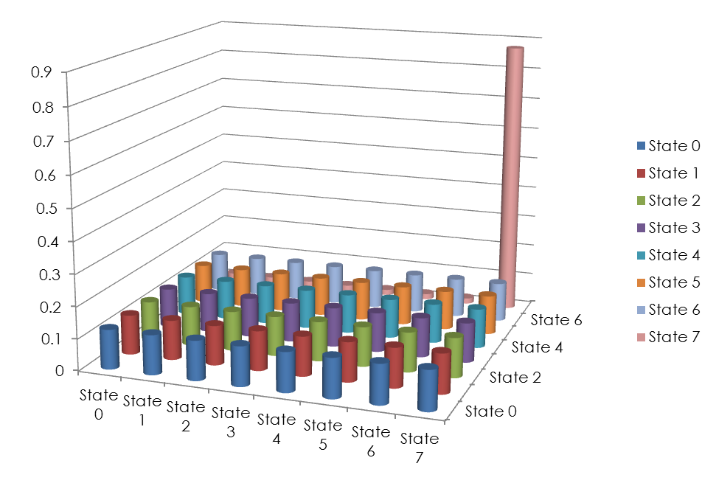
Results and Analysis
Transition Probability in 3:00 A.M.
State 7 → State 7

Slide 22
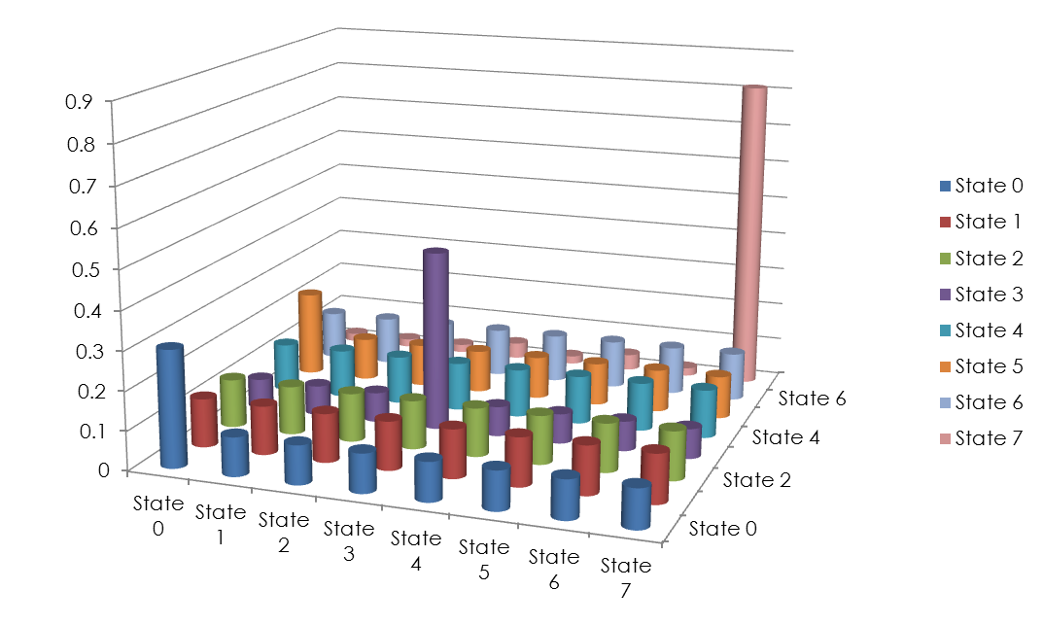
Results and Analysis
Transition Probability in 7:00 A.M.
State 7 → State 7
State 0 → State 0
State 3 → State 3
State 5 → State 0

Slide 23
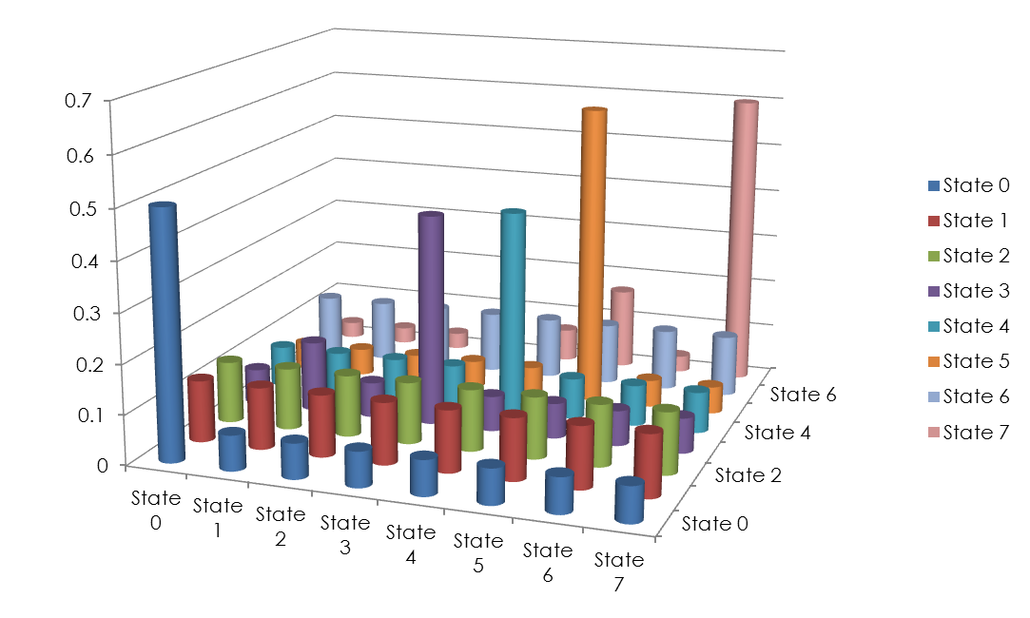
Results and Analysis
Transition Probability in 8:00 A.M.
State 5 → State 5
State 7 → State 7
State 0 → State 0
State 3 → State 3
State 4 → State 4

Slide 24
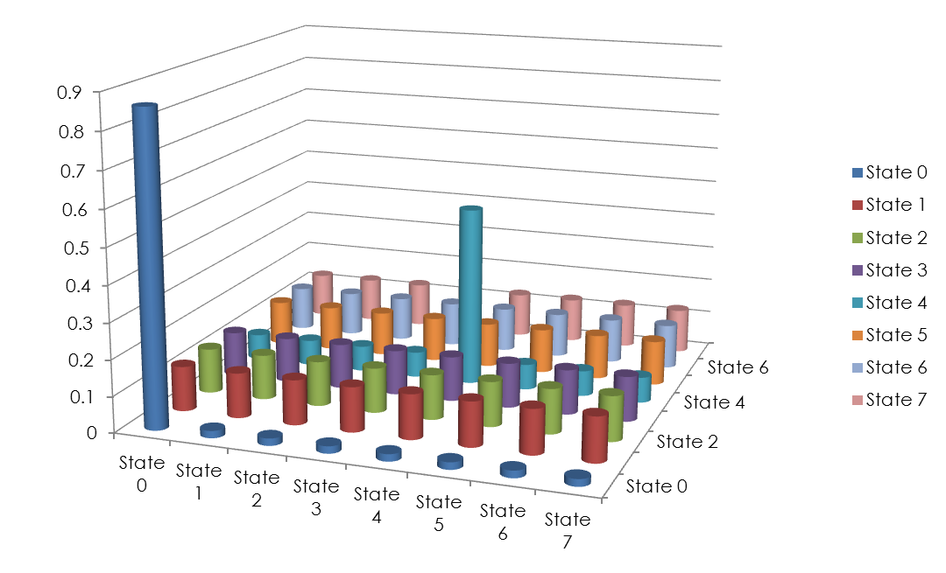
Results and Analysis
Transition Probability in 11:00 A.M.
State 0 → State 0
State 4 → State 4

Slide 25
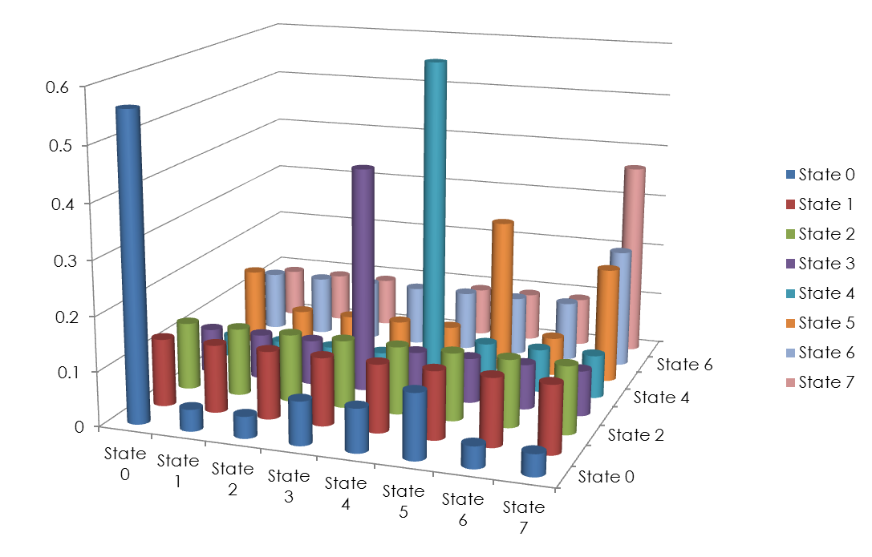
Results and Analysis
Transition Probability in 5:00 P.M.
State 0 → State 5
State 2 → State 3
State 5→ State 7

Slide 26
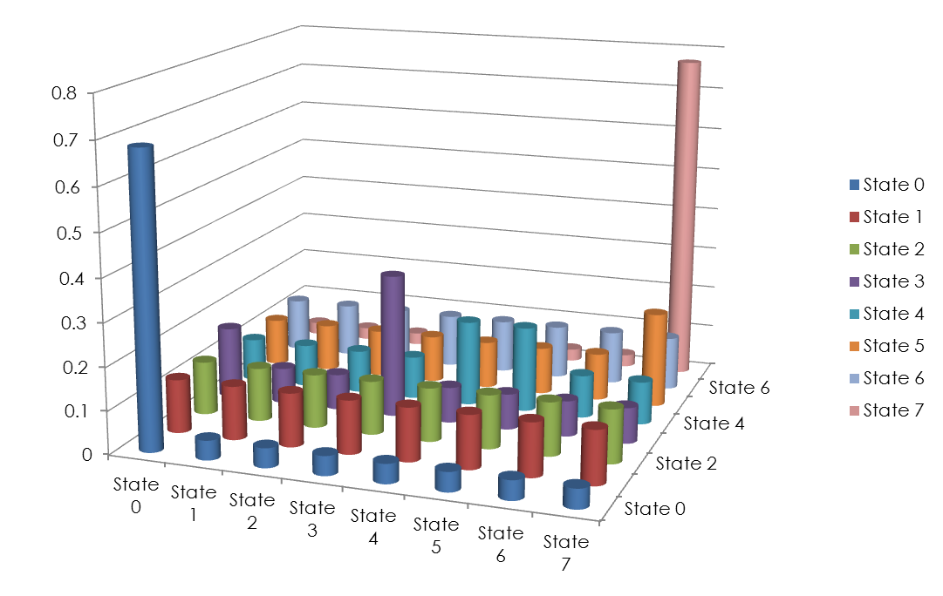
Results and Analysis
Transition Probability in 6:00 P.M.
State 3 → State 3
State 5 → State 7
State 7→ State 7

Slide 27
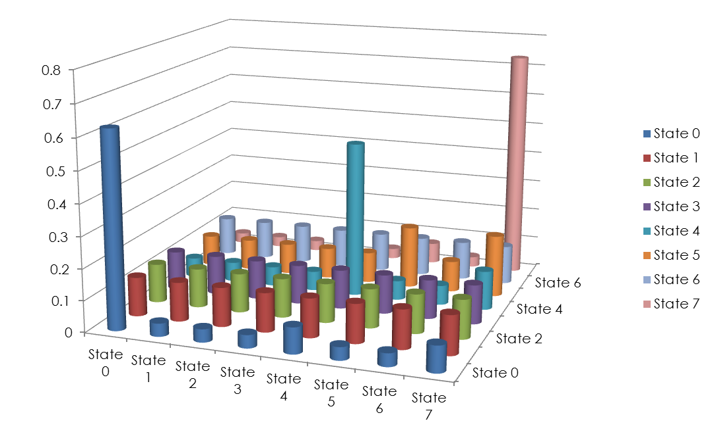
Results and Analysis
Transition Probability in 7:00 P.M.
State 4 → State 4
State 7 → State 7

Slide 28
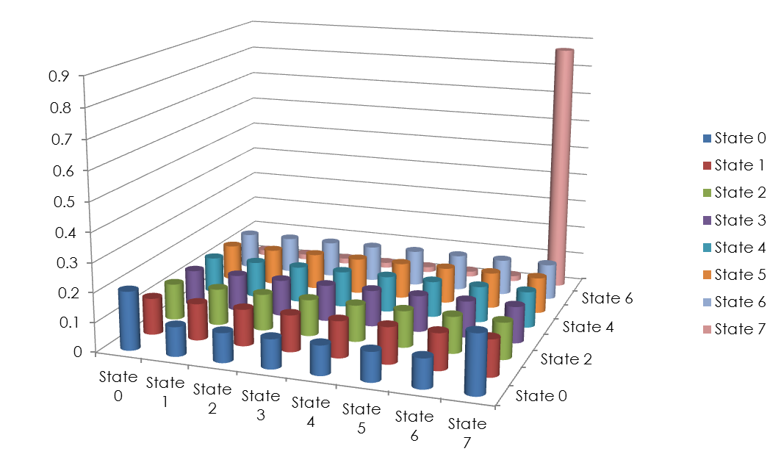
Results and Analysis
Transition Probability in 11:00 P.M.
State 7 → State 7

Slide 29
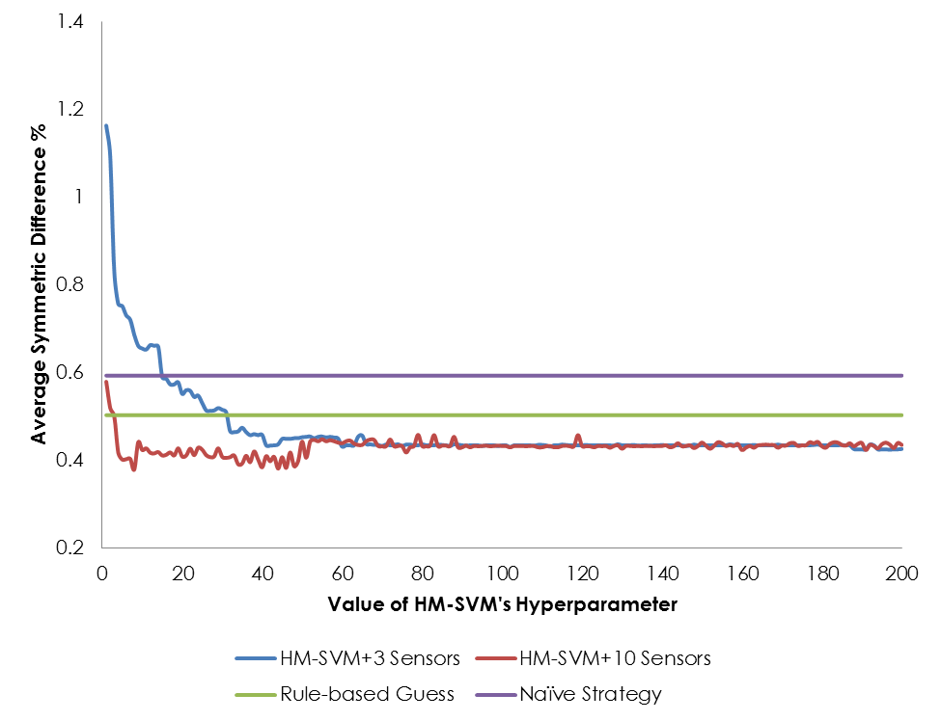
Results and Analysis

Slide 30
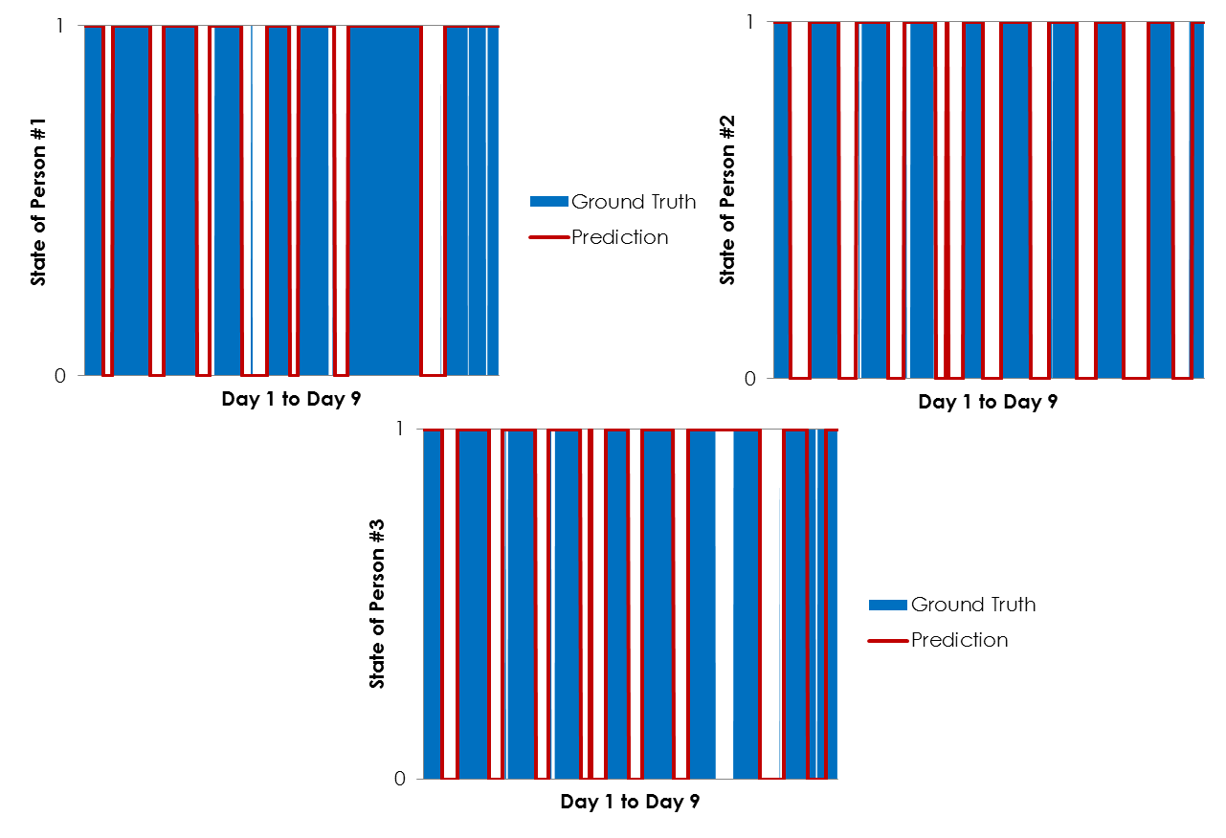
Results and Analysis

Slide 31
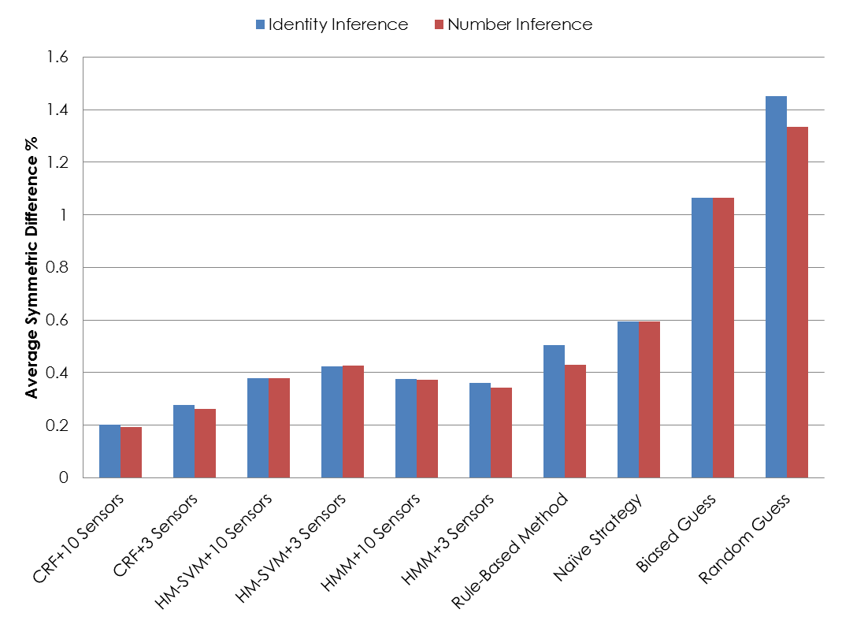
Results and Analysis

Slide 32
Conclusions
Anonymous Motion Sensors provide extra information
-Number
-Identity
-One third Error of the Naïve Strategy
-Even in the limited sensors scenario
-Without learning, inference is also possible
Future Exploration
-Room-Level Inference
-Combining Electric Meter Data and Water Meter Data

Slide 33
Acknowledgement
Gratitude to:
-Kevin, Samy, Chenguang and all the members in NESL, for their great help and understanding.
-Professor Mani Srivastava, for his guidance on a day to day basis.
-Members in UCLA and CSST Program, for the memorable and colorful summer you share with me.
Thanks for all of you!

